Slide 1

EOS
the next step in smart-contracts?
Presented by

Slide 2
Disclaimer
We are NOT in any way associated with block.one, the company developing EOS code. We are just part of the emerging EOS community.
We have no interest in you buying EOS tokens, and this certainly should not be treated as financial advice.
Our goal is to encourage you to take interest in the concept and possibly consider building businesses on top of EOS.

Slide 3
BLOCKCHAIN Evolution
System for simple payments (Bitcoin)
System for smart-contracts (Ethereum)
System for decentralized apps (EOS)

Slide 4
WHAT is a decentralized app?
Uber without the Uber company running it.

Slide 5
What does A decentralized app require?
Cheap to run
Free for the users
Easily accessible
No fancy cryptographic stuff
Bug recovery
Upgradability
Account recovery
Privacy protection
Access to other blockchains

Slide 6
HIGH PERFORMANCE

Slide 7
WHAT is high performance?
BTC: 4 trxn/sec
ETH: 15-30 trxn/sec
BTC: 8 bln USD/year (20 mln USD/day)
ETH: 4 bln USD/year (10 mln USD/day)
Source: eos.io, blockchain.info, etherscan.io

Slide 8
What Scaling solutions ARE available?
Moving transactions off-chain: state channels
Lightening Network in Bitcoin
Raiden in Ethereum
Splitting the problem into smaller chunks:
Sub-domains within one blockchain (e.g. Ethereum’s sharding)
A hierarchy of blockchains (e.g. Ethereum’s Plasma)

Slide 9
What is EOS?
EOS is a general-purpose smart-contract platform, just like Ethereum.

Slide 10
EOS is the blockchain for building commercial scale decentralized applications that are indistinguishable from centralized alternatives.
Daniel Larimer, CTO of block.one

Slide 11



HOW DOES EOS WORK?
Applications
Computer

Slide 12
HOW DOES EOS WORK?
Applications
Operating System
Computer

Slide 13
HOW DOES EOS WORK?
Applications
Operating System
EOS
Computer

Slide 14
What are eos main features?
?
?
?
?
?
?

Slide 15
What are eos main features?
Processing power
Built-in governance
Infrastructure for apps
No transaction fees
Upgradeable apps
Asynchronous communication

Slide 16
#1 Processing power
EOS MAIN FEATURES
On day one: 5,000 trxns per second. Ultimately: 100,000 trxns per second.
Source: eos.io

Slide 17
#1 Processing power
EOS MAIN FEATURES
Sequential processing technology borrowed from LMAX exchange
Parallel processing for horizontal scaling

Slide 18
#2 Built-in governance
EOS MAIN FEATURES
Consensus mechanism: DPOS (Delegated Proof of Stake)
Block producers able to freeze & fix broken apps
Complete governance structure:
Constitution encoded in the blockchain (legally binding)
Arbitration for resolving disputes
Shareholders voting on important decisions
EOS itself is a dApp

Slide 19
#3 infrastructure for apps
EOS MAIN FEATURES
Common/low-level features & services provided by the blockchain
Examples: account permissions, account recovery, scheduling, authentication, inter-app communication, biometric 2nd factor validation
Integrated storage solution based on IPFS (InterPlanetary File System)

Slide 20
#4 No transaction fees
EOS MAIN FEATURES
EOS token is never consumed, no transaction fees & no gas
If you own 1% of the tokens, you own 1% of the network
You can monetize your app any way you want

Slide 21
#5 Upgradeable apps
EOS MAIN FEATURES
Publish source code, not machine code
Human intentions part of blockchain consensus
Upgradable smart-contracts (optional)

Slide 22
#6 Asynchronous communication
EOS MAIN FEATURES
Everything is based on messages
Cross-blockchain communication becomes possible

Slide 23
What are eos main features?
Processing power
Built-in governance
Infrastructure for apps
No transaction fees
Upgradeable apps
Asynchronous communication

Slide 24
TWO WAYs OF BuildING A Smart-contract platform
From abtract to concrete
From concrete to abstract

Slide 25
Transactions on the most active blockchains (7-day average)
BitShares usage: 21.0% capacity utilized: <1%
Steem usage: 33.8% capacity utilized: <1%
Source: blocktivity.info

Slide 26
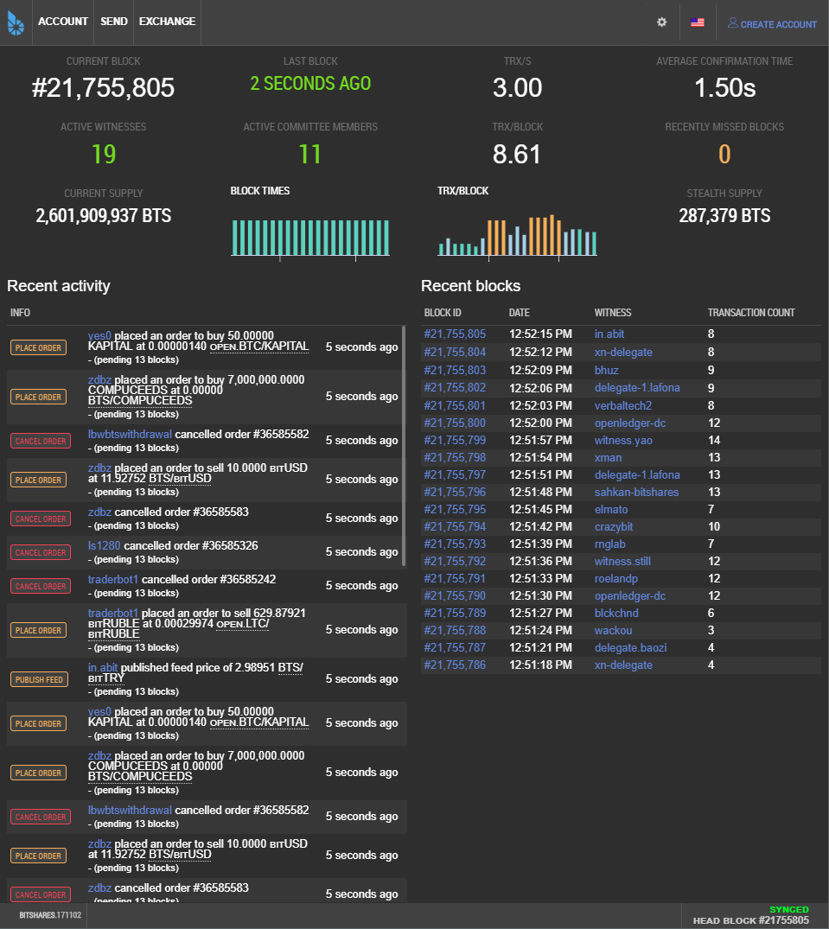
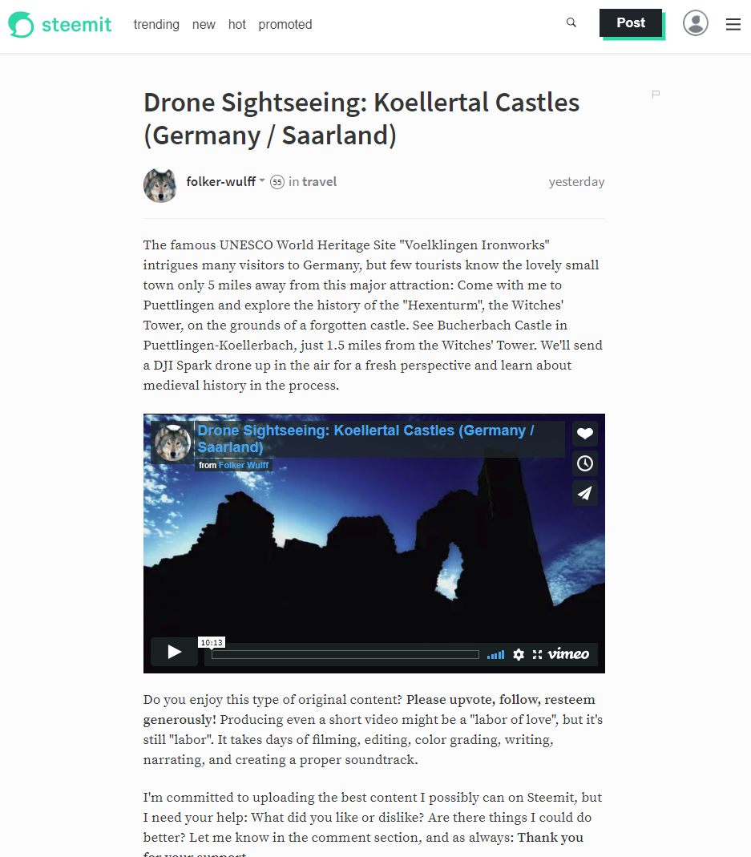
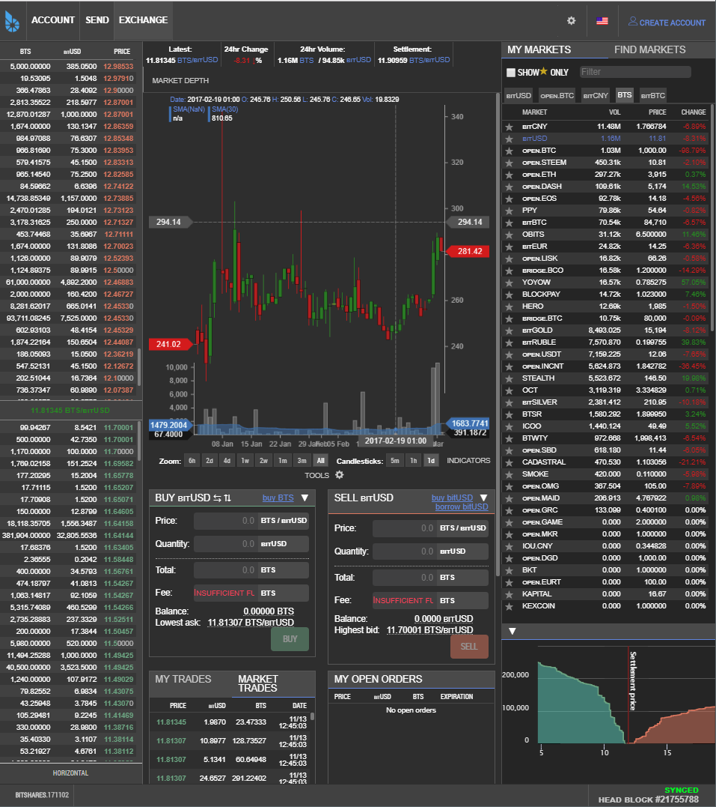
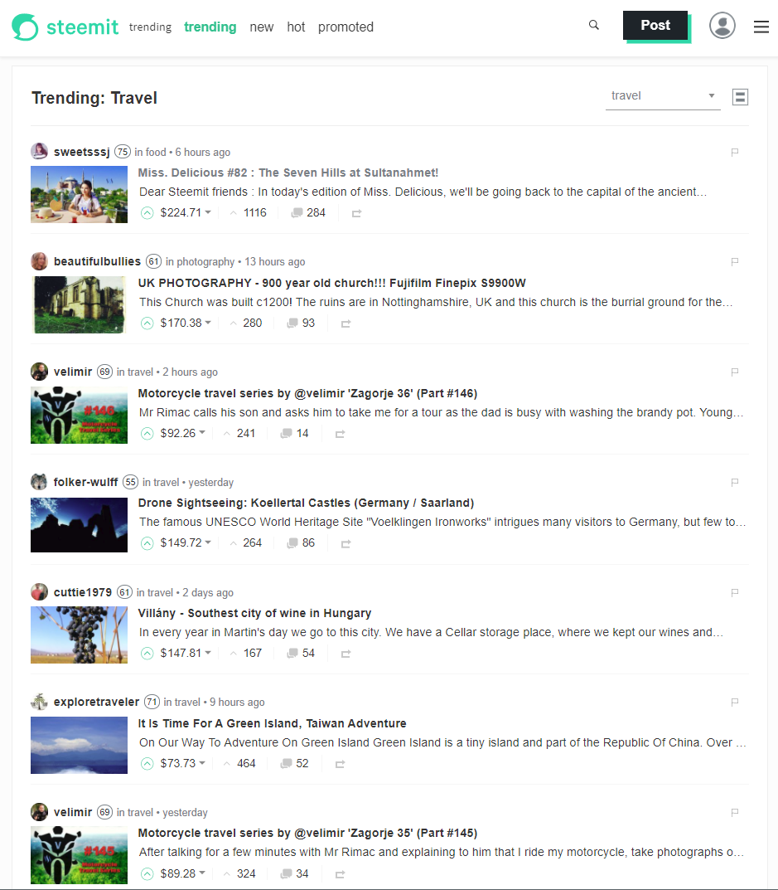
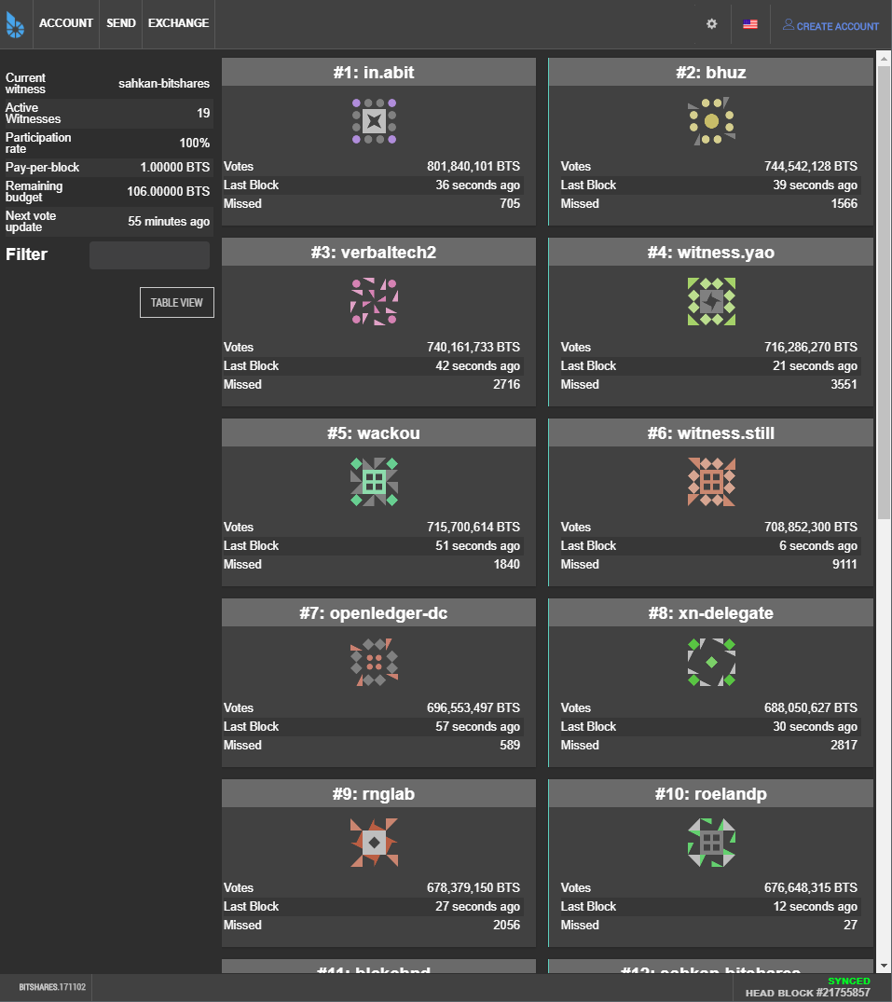
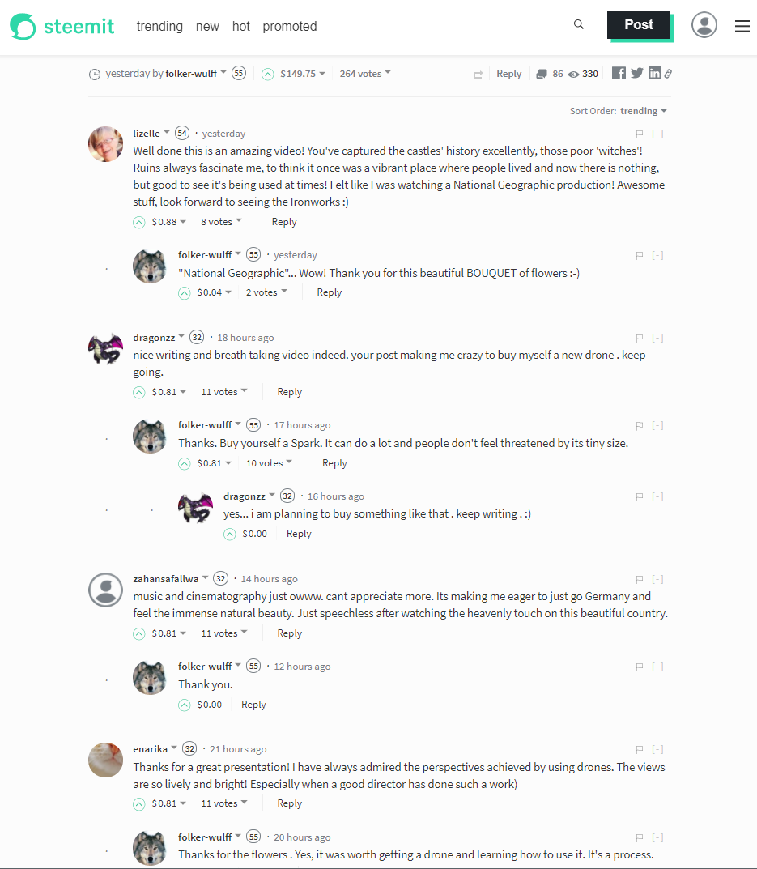
Source: bitshares.org & steemit.com

Slide 27
Could Bitshares & Steem be Hosted on any existing smart-contract platform?
Not enough processing power
Business model cannot be implemented

Slide 28
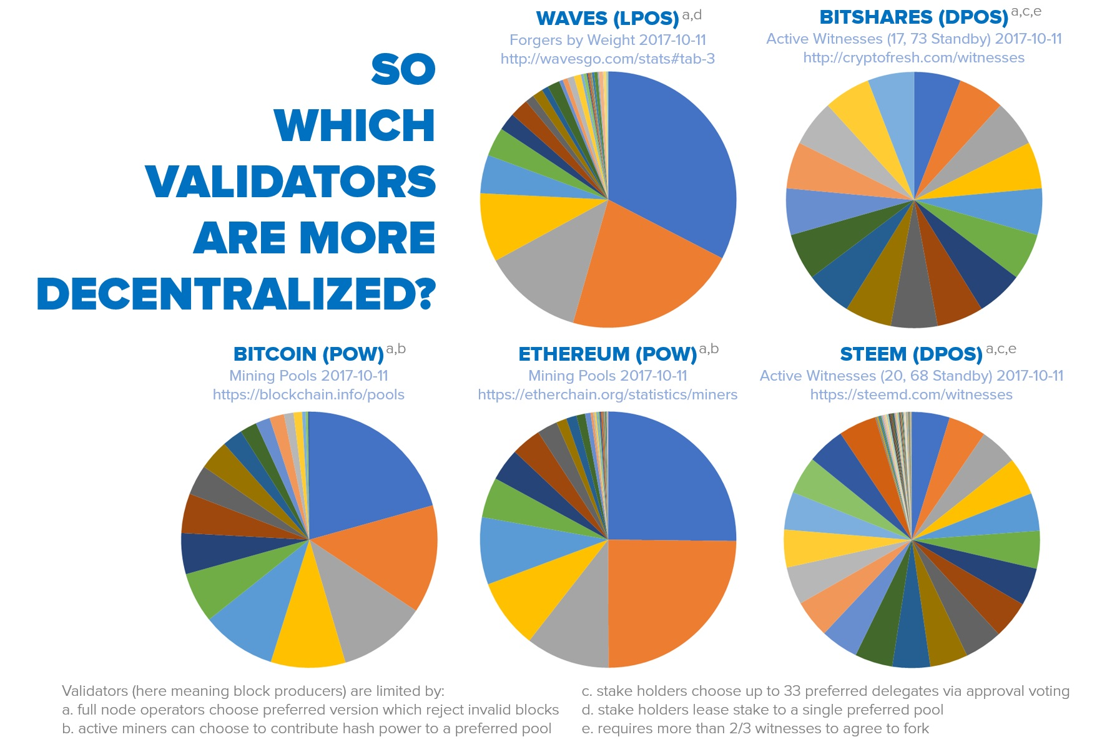
Delegated proof of stake (DPOS) HOW decentralized IS IT?
Source: senzheng on reddit.com

Slide 29
What are the strong points?
Very efficient team implementing a concept proved in practice
Web Assembly as a virtual machine
Strong financial backing: Brock Pierce & Bo Shen (Fenbushi Capital)
Commitment to spend 1 bln USD to boost the ecosystem

Slide 30
EOS is the most well-funded project in history and we plan to soon announce a program for up to one billion USD of capital for EOS projects.
Brendan Blumer, CEO of block.one

Slide 31
What are the weak points?
Almost non-existent ecosystem
C++ has a very steep learning curve
EOS code is hard to work with An act of constant balancing between cutting edge and bleeding edge
Track-record of poor documentation
Not live yet

Slide 32
EOS roadmap
Project started in Q1 2017
MVP stage called EOS Dawn 1.0
January 2018
EOS Dawn 3.0 All major functionalities deployed
Q1 & Q2 2018 devoted to testing and building development tools & docs
The EOS blockchain goes live in June 2018, most probably with the parallel processing feature already enabled
December 2017 EOS Dawn 2.0 Public testnet
Source: eos.io

Slide 33


EOS VS. decentralized apps requirements
Ethereum |  | EOS
 | Cheap to run
 | Free for the users
 | Easily accessible
? | No fancy cryptographic stuff
 | Account recovery
 | Privacy protection | ?
? | Access to other blockchains
? | Upgradability
 | Bug recovery

Slide 34
summary
Revolution or evolution?
Extremely business oriented
Can other systems copy EOS solutions?
Will EOS replace Ethereum?

Slide 35
BLOCKCHAIN Evolution
System for simple payments (Bitcoin)
System for smart-contracts (Ethereum)
System for decentralized apps (EOS)

Slide 36

About Tokenika - OUR ROLE IN EOS ECOSYSTEM
Applications
Development Tools
EOS

Slide 37
About Tokenika - WHAT WE DO
Focus on blockchain-based fundraising and digital asset management solutions, e.g. Neufund, Melonport, Iconomi
Software house for building dApps (both on EOS and Ethereum)
Aiming to be elected as one of the 20 block producers for EOS

Slide 38
What we need
Not looking for funding, looking for ways to spend money
Looking for good ideas that can be converted into dApps
Hiring developers with background in C++ and/or Ethereum smart-contracts

Slide 39





Partnership announcement

Slide 40
Thank you
EOS - official website
www.eos.io
Any questions?
Presented by
www.tokenika.io contact@tokenika.io
facebook.com/groups/Tokenika facebook.com/groups/EOSPolska

